Slide 1
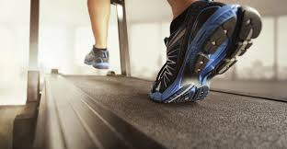
HUMAN POWER GENERATION
DEEPIKA.C
SHYAM SUNDAR.S
ABHISHEK BHARADWAJ
INAMUL HASSAN

Slide 2
Who needs what because why
Problem Statement
People need electricity in its cheapest form because it is expensive and unaffordable

Slide 3
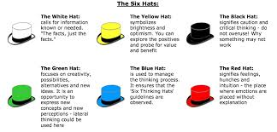
6 THINKING HATS

Slide 4


6 THINKING HATS
BLUE HAT –
Cheapest ways of generating electricity
WHITE HAT
India has suffered consistent power shortages since independence
60% electricity is generated from coal and lignite
Only 9 states in the country have been officially declared totally electrified

Slide 5


YELLOW HAT –
Renewable
Environment Friendly
Green source of energy
It can be used as a backup source of energy
BLACK HAT
Very less energy is generated
Cost for implementation is high

Slide 6


RED HAT:
Most of the people don’t use treadmill so how it is going to generate electricity
GREEN HAT:
Electricity can be generated in all rotating objects including bicycles.

Slide 7
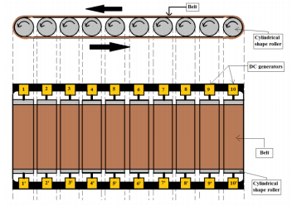
WORKING:
In bicycle generator, where a small dc generator is attached to one of the wheel of a bicycle when the bicycle is running the rotor of the generator also rotates
Similarly, when a person walks on a treadmill, dynamo is made to rotate.
From dynamo, electric power is obtained.
This power is stored in a storage device or can be utilized directly.

Slide 8
IMPACT
It becomes easier to generate electricity
It becomes cheaper
Energy is not being wasted
MARKET
There may be estimated raise of 20% in electric economy
No of users will be increased
COMPETITION
It faces huge competition from other forms of natural energy like solar ,tidal,wind,hydro electric energies etc

Slide 9
SCAMPER
S-
C-trade mill + dynamo
A-mechanical->electrical
M-
P-
E-
R-

Slide 10
HELP
FINANCIAL HELP
An estimated amount of RS 30000 is expected
MARKETING HELP
Social media, Government websites can be used for publicity
STRATEGIC KNOWHOW
A clear mission
A lived ownership culture
A consistent strategy

Slide 11
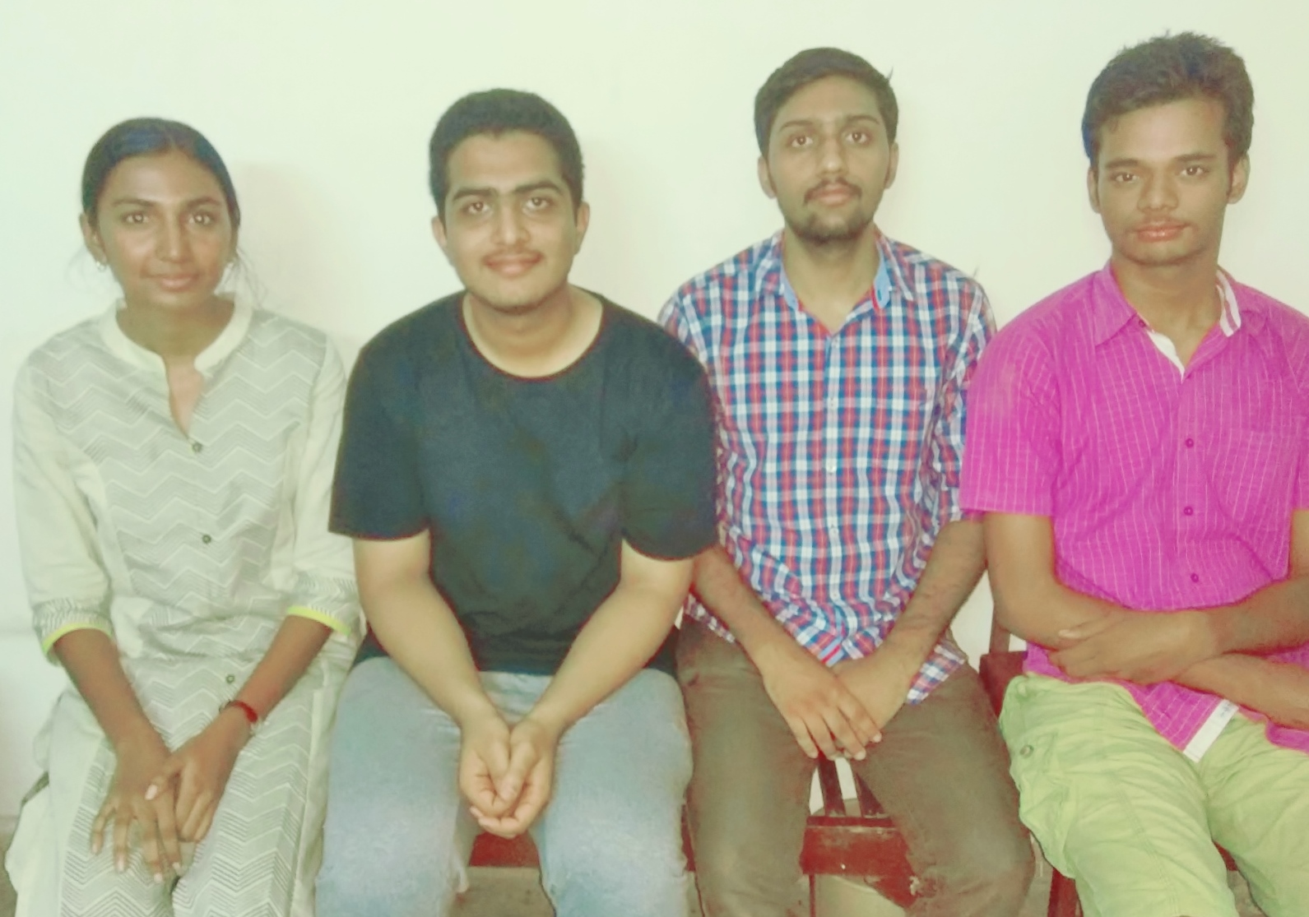
GROUP MEMBERS

Slide 12


